Slide 1
Module-5:
GUI PROGRAMMING AND APPLETS

Slide 2
What is GUI?

Slide 3
AWT class:
The AWT (Abstract Window Toolkit) is a key part of Java's original graphical user interface (GUI) framework. It provides a set of classes for building user interfaces (UI) like windows, buttons, text fields, and menus.
Java AWT (Abstract Window Toolkit) is an API to develop Graphical User Interface (GUI) or windows-based applications in Java.
The java.awt package provides classes for AWT API such as TextField, Label, TextArea, RadioButton, CheckBox, Choice, List etc.

Slide 4
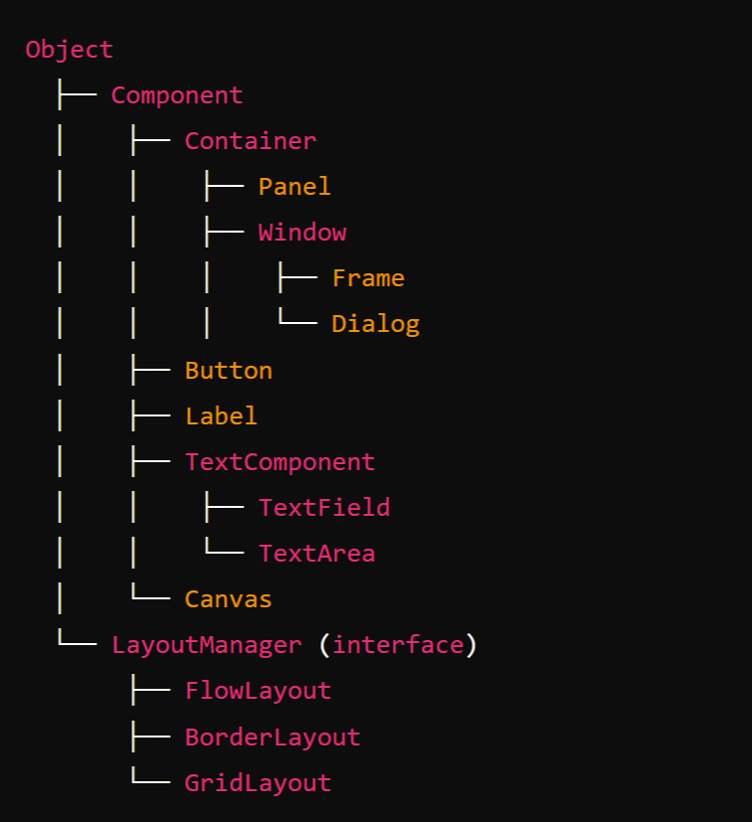
1. Object
The root of the class hierarchy in Java. All classes inherit from Object, including those in AWT.
2. Component (extends Object)
The base class for all AWT components. It represents the common attributes and behaviors of UI elements, such as buttons, labels, text fields, etc.
Key subclasses of Component:
Container: Can contain other components.
Button: Represents a clickable button.
Label: Displays a text string.
TextComponent: Base class for TextField and TextArea.
Scrollbar: Adds a scrollbar to a component.
Canvas: Provides a blank area on which custom drawing can be done.

Slide 5
3. Container (extends Component)
A specialized component that can hold other components (like panels, frames).
Important subclasses:
Window: Represents a top-level window with no borders or menus (typically used for creating dialogs or windows).
Frame: A fully functional window with title, borders, and buttons like minimize, maximize, and close.
Dialog: A pop-up window used to capture user input.
Panel: A container for organizing components in a specific layout. Frequently used for grouping elements.
4. TextComponent (extends Component):
The base class for text-related components.
Subclasses:
TextField: A single-line text input field.
TextArea: A multi-line text input area.

Slide 6
5. Window (extends Container):
A top-level window with no borders or menus.
Subclasses:
Frame: A basic window with a title bar, close, minimize, and maximize buttons.
Dialog: A pop-up window often used to interact with the user.
6. Frame (extends Window):
The main window used for GUI applications, containing title bars and window controls (minimize, close, etc.).
7. Panel (extends Container)
A generic container used for grouping other components.
8. LayoutManager
An interface used to define how components are arranged in a container.
Key implementations:
FlowLayout: Lays out components in a row.
BorderLayout: Arranges components in five areas (North, South, East, West, and Center).
GridLayout: Arranges components in a grid of rows and columns.

Slide 7
Swing:
Swing is a part of Java's JFC (Java Foundation Classes) and is a more advanced and flexible GUI toolkit compared to AWT (Abstract Window Toolkit). While AWT provides basic components and is platform-dependent (uses native GUI components), Swing is built on top of AWT and is platform-independent because it renders its components using Java code rather than relying on the underlying operating system's native components. This allows for a more consistent look and feel across different platforms.

Slide 8
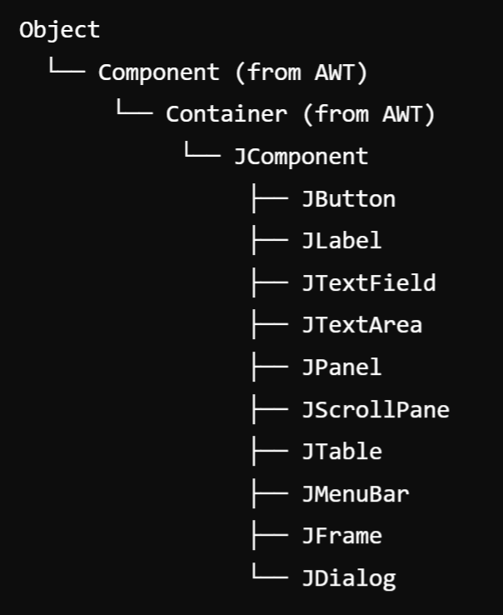
Hierarchy for Swing components:
The Swing component hierarchy in Java follows a well-defined structure based on the AWT hierarchy but adds its own set of components for creating rich user interfaces.
1. Object
The root class of all Java classes.
2. Component (from AWT)
The base class for all graphical components that can be added to a GUI.
3. Container (from AWT)
A subclass of Component that can hold other components (like panels or frames).
4. JComponent (extends Container)
The base class for all Swing components. It provides additional functionality such as double buffering, borders, and tooltips.

Slide 9
Core Swing Components (Subclasses of JComponent):
Component | Description
JButton | Represents a clickable button.
JLabel | Displays static text or an image.
JTextField | A single-line text input field.
JTextArea | A multi-line text area for text input or output.
JPanel | A generic lightweight container used for organizing components.
JScrollPane | Provides a scrollable view of another component, like a text area or table.
JTable | A component that displays tabular data in rows and columns.
JList | Displays a list of items.
JComboBox | A drop-down list that allows the user to select one item from a list of choices.
JCheckBox | A component that represents a check box (on/off state).
JRadioButton | Represents a radio button (allows selection of one option within a group).
JMenuBar | Components for creating a menu bar.
JMenu | Represents a menu within a menu bar.
JMenuItem | Represents an item within a menu.

Slide 11
Top-Level Containers
JFrame (extends Frame):
A top-level window that contains the main application window.
2. JDialog (extends Dialog):
A pop-up window for user interaction (e.g., confirmation dialogs).
3. JWindow (extends Window)
A window without any borders or title bar.
4. JApplet (extends Applet):
A container for applets, used in embedding GUI components in web browsers.
5. JToolBar:
Provides a set of actions or controls, often used for creating toolbars.

Slide 12
Specialized Components:
JTabbedPane
Manages multiple components with tabs, allowing the user to switch between them.
2. JSpinner
Allows the user to select a value from a sequence of values (like a number spinner).
3. JProgressBar
Displays the progress of a task.
4. JTree
Displays a hierarchical tree of data (e.g., a file directory structure).

Slide 13
Swing v/s AWT
Feature | AWT (Abstract Window Toolkit) | Swing (Java Foundation Classes)
Component Model | Uses native OS components, making it platform-dependent. | Built entirely in Java, providing a consistent look and feel across platforms.
Lightweight vs. Heavyweight | Heavyweight components (each AWT component is a wrapper around a native system component). | Lightweight components (not tied to native components, allowing more flexibility and customization).
Look and Feel | Limited to the platform’s native look and feel. | Supports pluggable look and feel, allowing for greater customization and different styles.
Event Handling | Uses a simpler event handling model based on listener interfaces. | Provides a more advanced event handling model with more event types and capabilities.
Graphics | Basic graphics capabilities, primarily for drawing shapes and text. | Richer graphics capabilities, including advanced rendering and painting options.
Containers | Limited container options (e.g., Frame, Panel). | More flexible container hierarchy (e.g., JFrame, JPanel, JLayeredPane).
Performance | Generally faster for simple applications due to native components. | Slightly slower due to the overhead of additional features and abstraction.
Threading Model | Not as robust, leading to potential issues with performance and responsiveness. | Supports the SwingWorker class for better concurrency management in UI updates.
Availability | Part of the original Java AWT library. | Introduced later as part of Java 2 (JFC) and is now standard in Java applications.
Development Complexity | Easier for simple GUIs, but can become complex for larger applications. | More complex to learn due to its rich feature set but offers better support for larger applications.

Slide 14
Jframe:
A JFrame is one of the most important classes in the Java Swing library. It is a top-level container that represents a window in a graphical user interface (GUI) application.
JFrame provides a window with all the standard window features, such as a title bar, minimize/maximize buttons, and a close button.

Slide 15
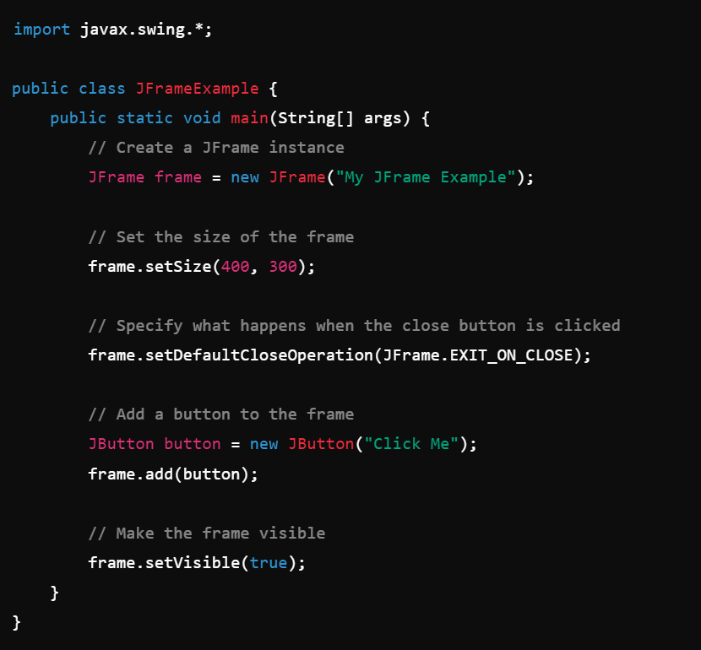
Example:

Slide 16
JApplet :
JApplet is a class in the Java Swing library that extends the Applet class and provides a framework for building applets with a Swing-based graphical user interface (GUI).
Applets are small Java programs that are typically embedded within a web page and run in a web browser. JApplet was designed to use the rich, lightweight components from Swing, as opposed to the heavyweight AWT components used in Applet.

Slide 17
JDialog:
JDialog is a part of the Java Swing library and is used to create dialog windows, which are smaller windows that appear on top of the main application window (JFrame).
Unlike JFrame, which represents a full-fledged window, JDialog is typically used for temporary, pop-up windows that require user interaction, such as alerts, confirmations, or input forms.
Jpanel:
JPanel is one of the most commonly used components in the Java Swing library. It is a lightweight container that can hold and organize a group of components, such as buttons, labels, text fields, or other panels. It serves as a flexible, invisible container to help structure the layout of GUI.

Slide 18
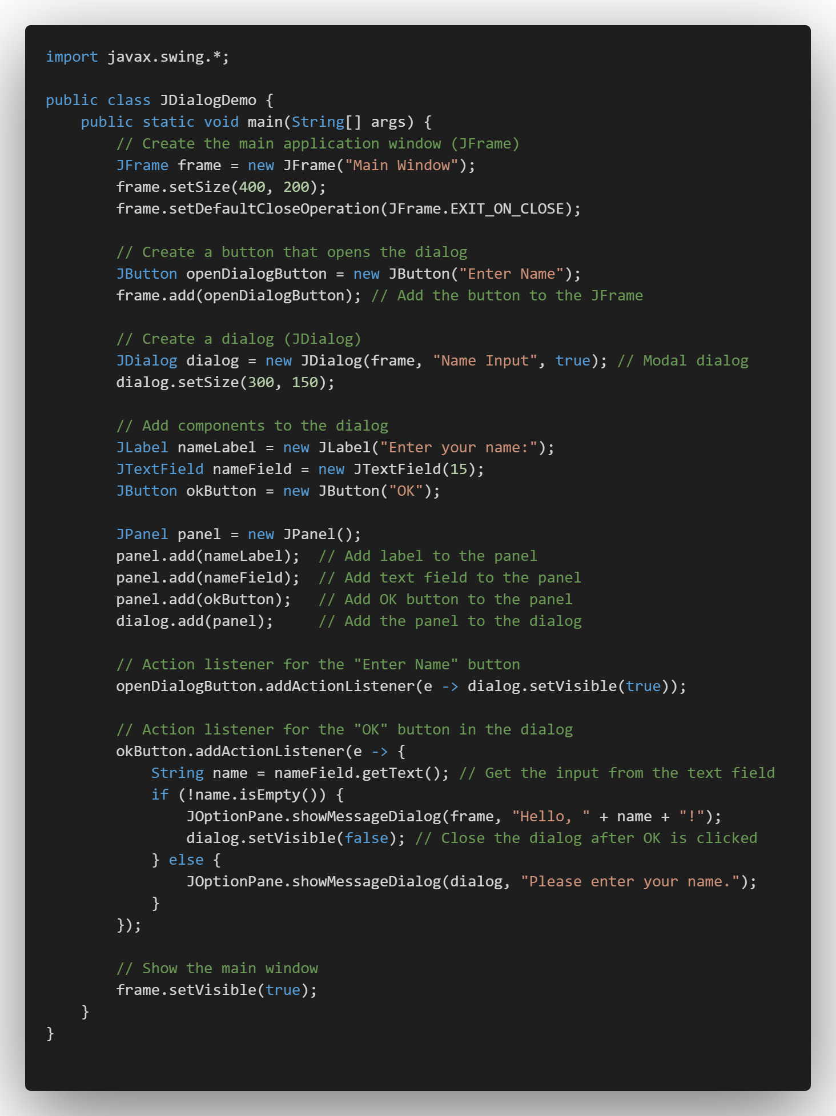
Example:
JDialog
Jpanel
Jlabel
JTextField
JButton

Slide 21
Module-5: GUI PROGRAMMING AND APPLETS (6)
GUI Programming with Java: The AWT class hierarchy, introduction to swing, swings Vs AWT, hierarchy for swing components.
Containers: JFrame. JApplet, JDialog. Jpanel,
Overview of some swing components: JButton, JLabel, JTextField, JTextArea, simple applications.
Layout management: Layout manager types, border, grid and flow.
Applets: Inheritance hierarchy for applets, differences between applets and applications, life cycle of an applet, passing parameters to applets.

Slide 22
Applet:
An applet in Java is a small application that can run in a web browser or applet viewer.
Applets were primarily designed to provide interactive features in web pages, but over time their usage has decreased, especially with the shift towards modern web technologies like HTML5, JavaScript, and CSS.

Slide 23
What is an Applet?
An applet is a subclass of java.applet.Applet or javax.swing.JApplet.
It is a Java program embedded into web pages and can be executed using a Java-enabled browser or an applet viewer tool.
Applets are different from standalone applications because they don't have a main() method. Instead, they rely on lifecycle methods for execution.
Types of Applets:
AWT Applet (java.applet.Applet): Uses Abstract Window Toolkit (AWT) components like Button, Label, TextField.
Swing Applet (javax.swing.JApplet): Uses Swing components like JButton, JLabel, JTextField. It offers more advanced GUI components compared to AWT.

Slide 24
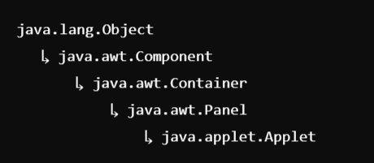
Inheritance hierarchy for applets:
In Java, applets are part of the class hierarchy that ultimately inherits from the base class java.lang.Object. Applets can be written using either the Abstract Window Toolkit (AWT) or Swing.
AWT Applet Inheritance Hierarchy:
AWT-based applets inherit from the java.applet.Applet class, which in turn inherits from other standard Java classes. Here is the detailed inheritance hierarchy:

Slide 25
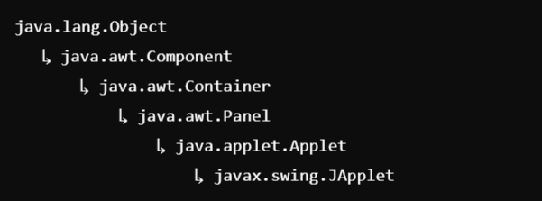
Swing Applet Inheritance Hierarchy:
Swing-based applets inherit from javax.swing.JApplet, which adds more advanced GUI capabilities by utilizing the Swing toolkit.
Hierarchy:

